Slide 1

Developed By:
ISAS
Andika saputra
Ugi Ispoyo Widodo
NIIT

Slide 2
DEFINITION OF BARCODE
Barcode is an optical machine-readable representation of data relating to the object to which it’s attached. Barcode can be described as an optical Morse code. It’s the small image of lines (bars) and spaces that is affixed to identification the information.

Slide 3
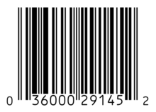
DEFINITION OF Linear Barcode
Linear Barcode, the information inside the code is linearly, encoded with intervals of alternating diffuse reflectivity (highs and lows signal-wise), usually black and white in color.

Slide 4
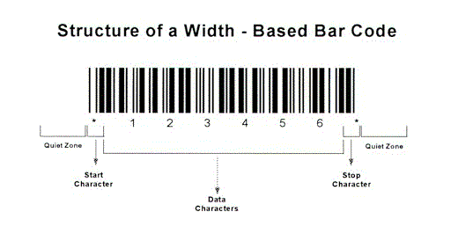
The Architecture of Linear Barcode
Linear barcode have a structure like a quite zone before the start character and after stop character, start character and stop character, Inter character gap (only used in discrete codes) and Data Character.

Slide 5
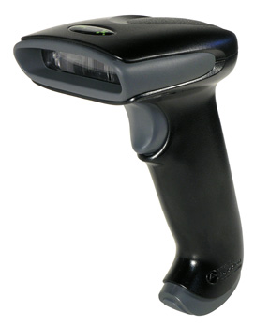
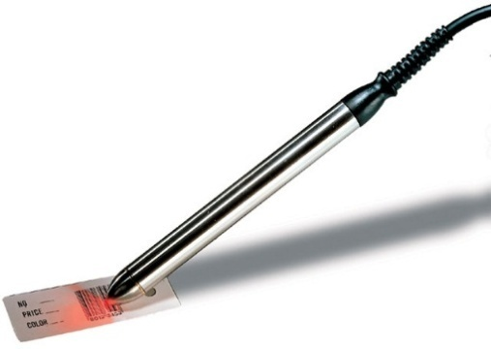
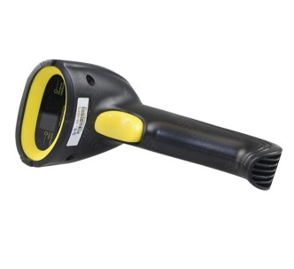
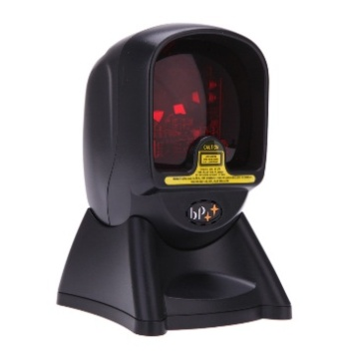
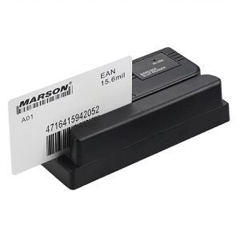
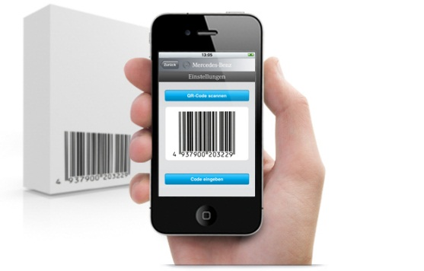
Barcode READER TOOLS
CCD (Charge-Coupled Device) Reader
Pen-Type Reader
Laser Scanner
Omni-DirectionalBarcode Scanner
Slot Barcode Scanner
Camera-Based Image Scanner

Slide 6
Implementation of Application Barcode Reader on Barcode Scanner
1. Open the barcode scanner application.
2. Point the camera into the linear barcode.
3. Scan the linear barcode using user Android Device.
4. When the linear barcode already scanned, it will give a result.
5. Then user can check the character of the result scanning the linear barcode in the last by click Web Search.
6. Then, the information of linear barcode that scanned in the last, it will be display what the product / information have in the linear barcode.

Slide 7
Advantages of Barcode Scanner
The people could know the details of the barcode that we scan to look for the code on the Internet.
Easier to use than a regular barcode scanner, simply by downloading the barcode reader application.
Can be use wherever user are, because it’s portable device that no need depends on anything else (except the camera).
Can be used with everyone’s.
Very Low-Price.

Slide 8
Disadvantage of Barcode Scanner
During dark conditions, the barcode will be hard and can be impossible to scanning, because isn'tuse an infrared laser to processing the scanning linear barcode.
Requires an Internet connection to browse the details of the barcode that has been read.

Slide 9
Thank You

